Slide 1

HTML and CSS

Slide 2
HELLO!
Ye Yint Oo
B.Sc(Hons) Business IT, University of Greenwich

Slide 3
What is HTML and CSS?
1

Slide 4
HTML
Hypertext markup language – creating framework of webpages.
HTML works by telling web browser how to display web pages.

Slide 5
CSS
Cascading Style Sheet – Style sheet by designing web pages that are written in HTML
Inline CSS, Internal CSS and External CSS

Slide 6
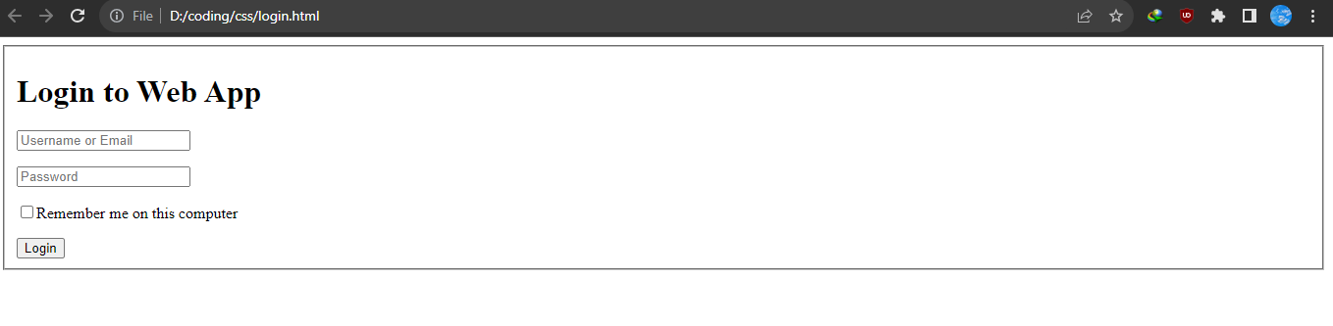

Only HTML
HTML with CSS

Slide 7
What is Flexbox?

Slide 8
One dimensional layout that has flexible and can do arrangement and alignment of items
Flexbox can build either in row and column
Advantages
- It can easily create responsive design with different screen sizes
- Auto adjust equal height columns and margin
- Browser Compatibility
- Easy to change direction of flex items

Slide 9


Pricing Table Flexbox
Grid Photo Gallery Flexbox

Slide 10
Flexbox Module Layout
display : flex
flex-direction
flex-wrap
justify-content
align-items
Align-content

Slide 11
Display : flex
When we use display : flex, child elements on parents elements are automatically arranged columns and row
Also auto width and height
Let’s demonstrate about it…..

Slide 12
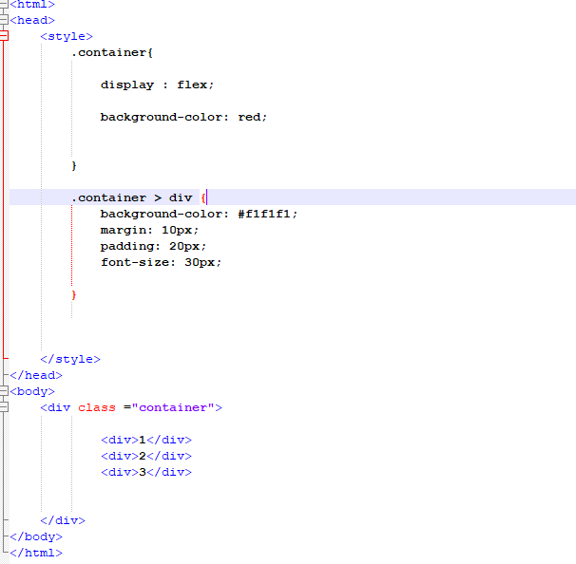
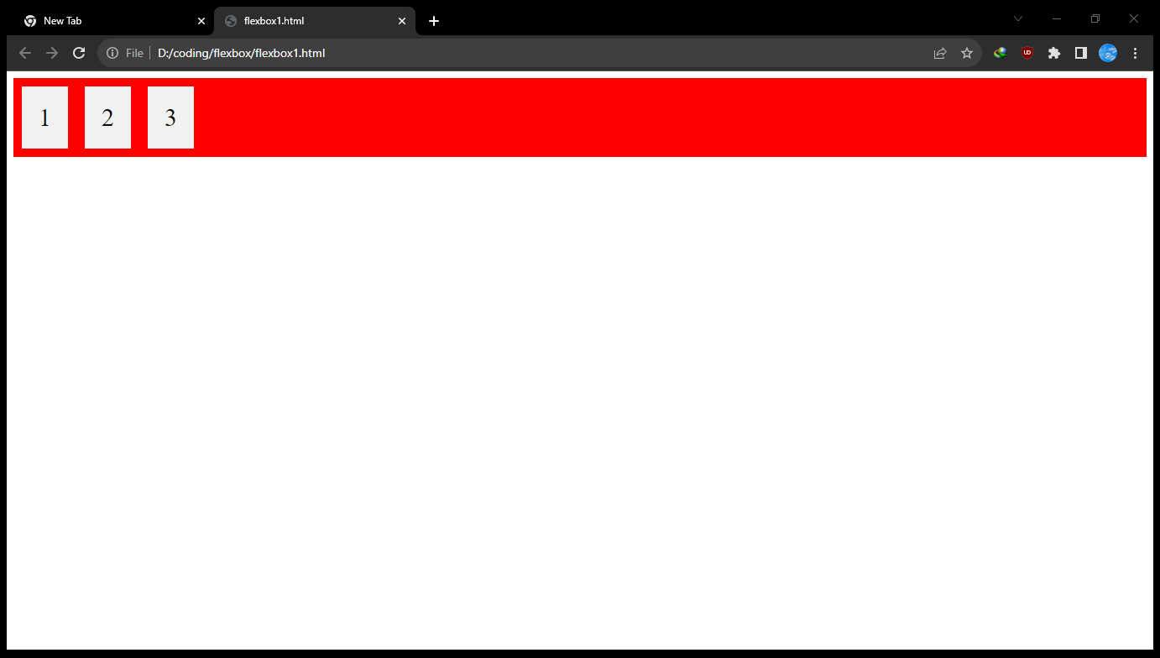

Slide 13
Flex direction
It displays the direction of flex items in row or column
There have 4 properties – row, row-reverse, column and column-reverse.
Let’s demonstrate about it…..

Slide 14
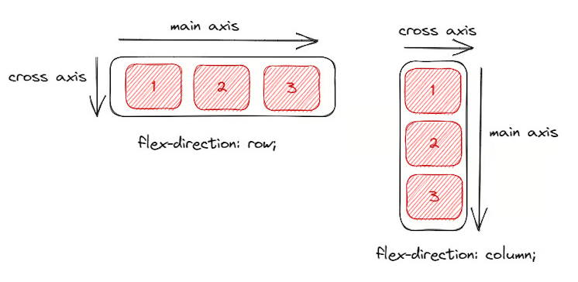
Different cross axis and main axis depending on flex row and column

Slide 15
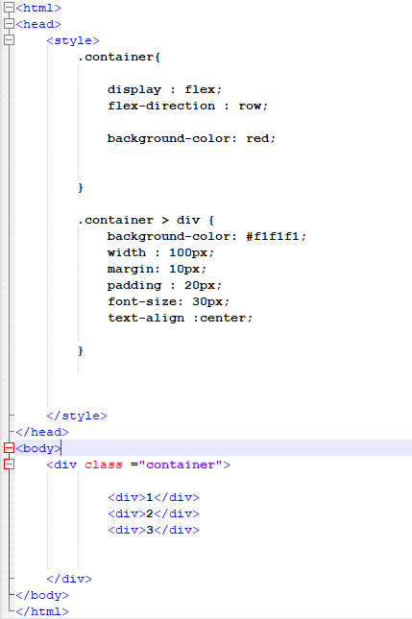
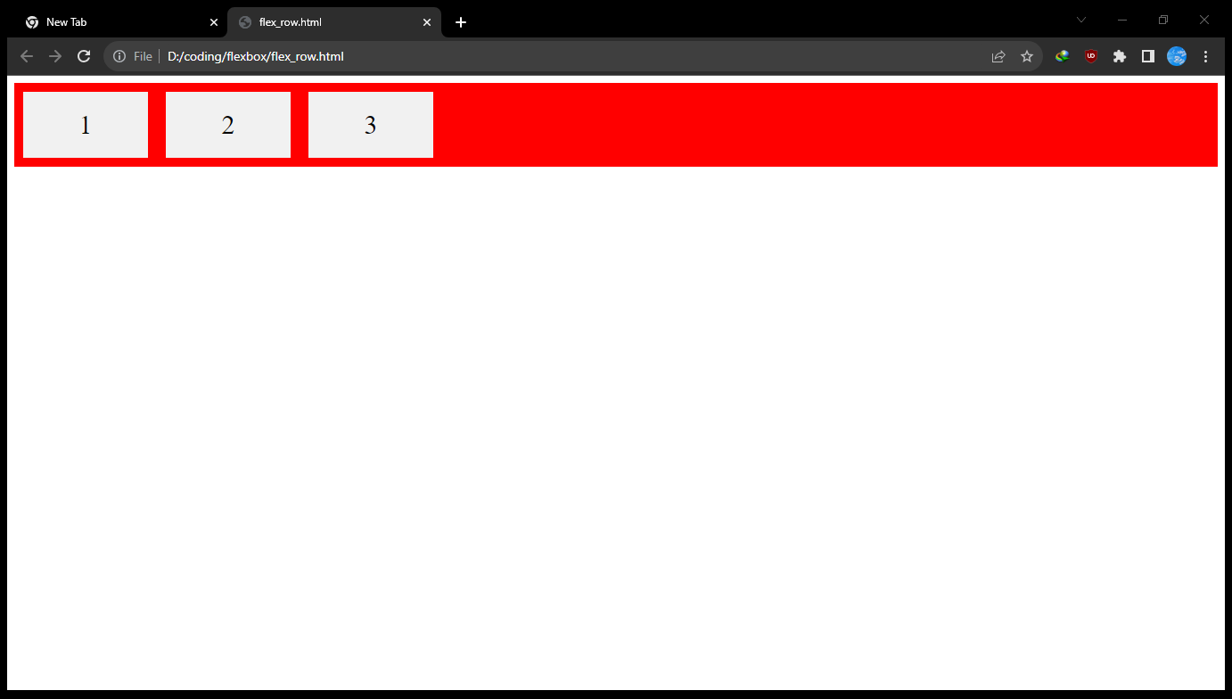
Flex row

Slide 16
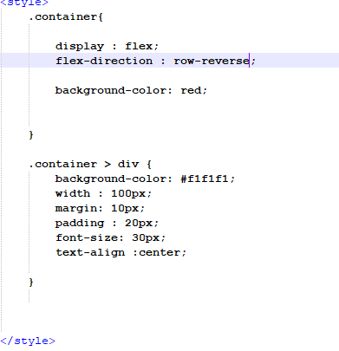
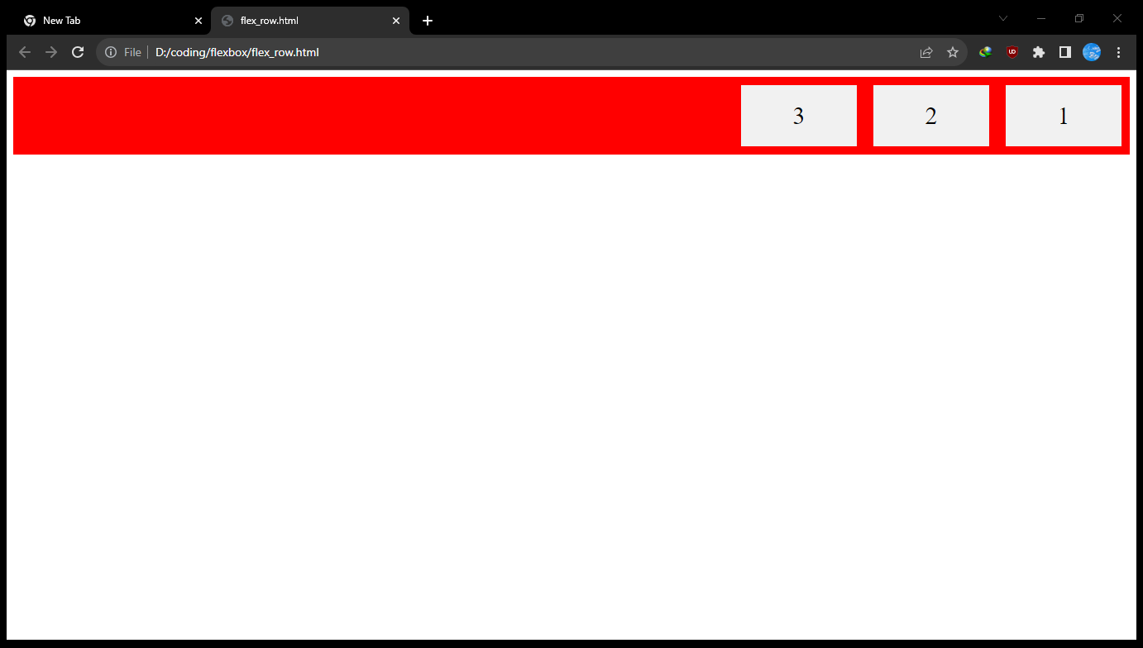
Flex row-reverse

Slide 17
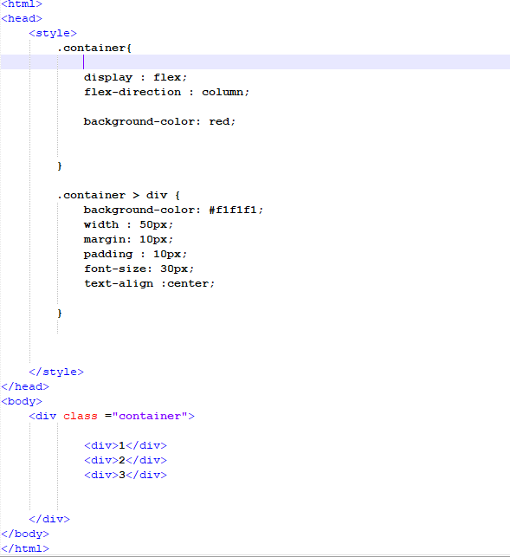
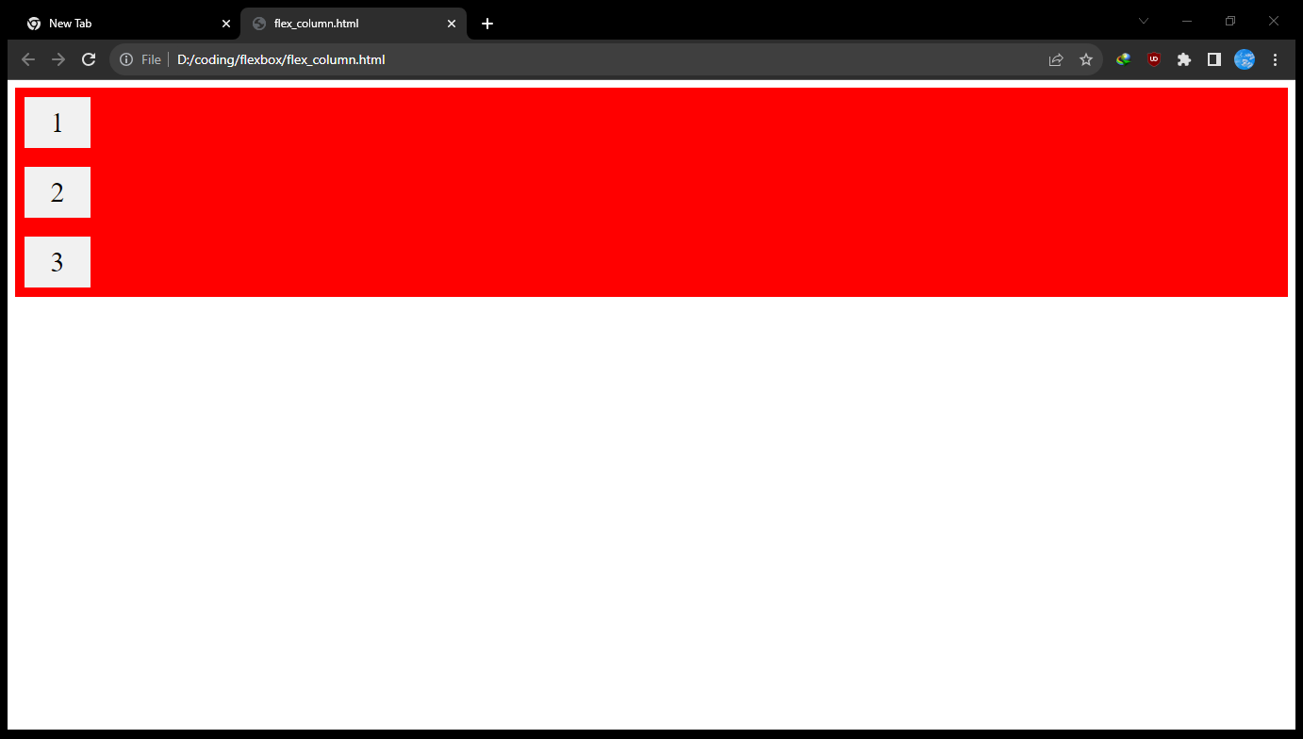
Flex column

Slide 18
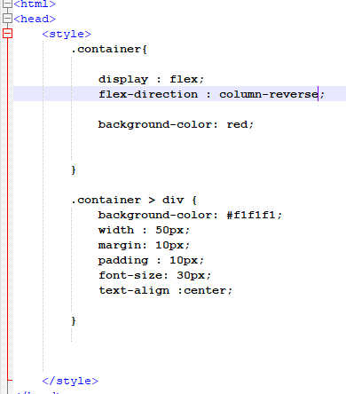

Flex column-reverse

Slide 19
Flex-wrap
It make all flex items try to fit into one line and can also changes
There are three type of properties – nowrap, wrap and wrap-reverse
Let’s demonstrate it…..

Slide 20
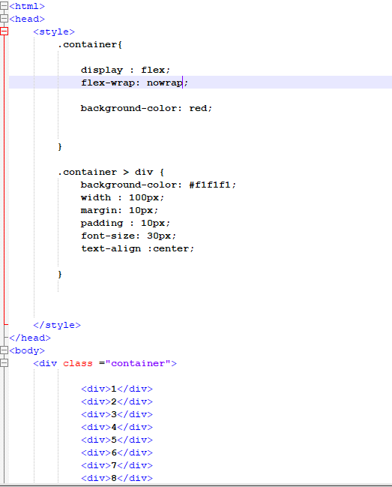
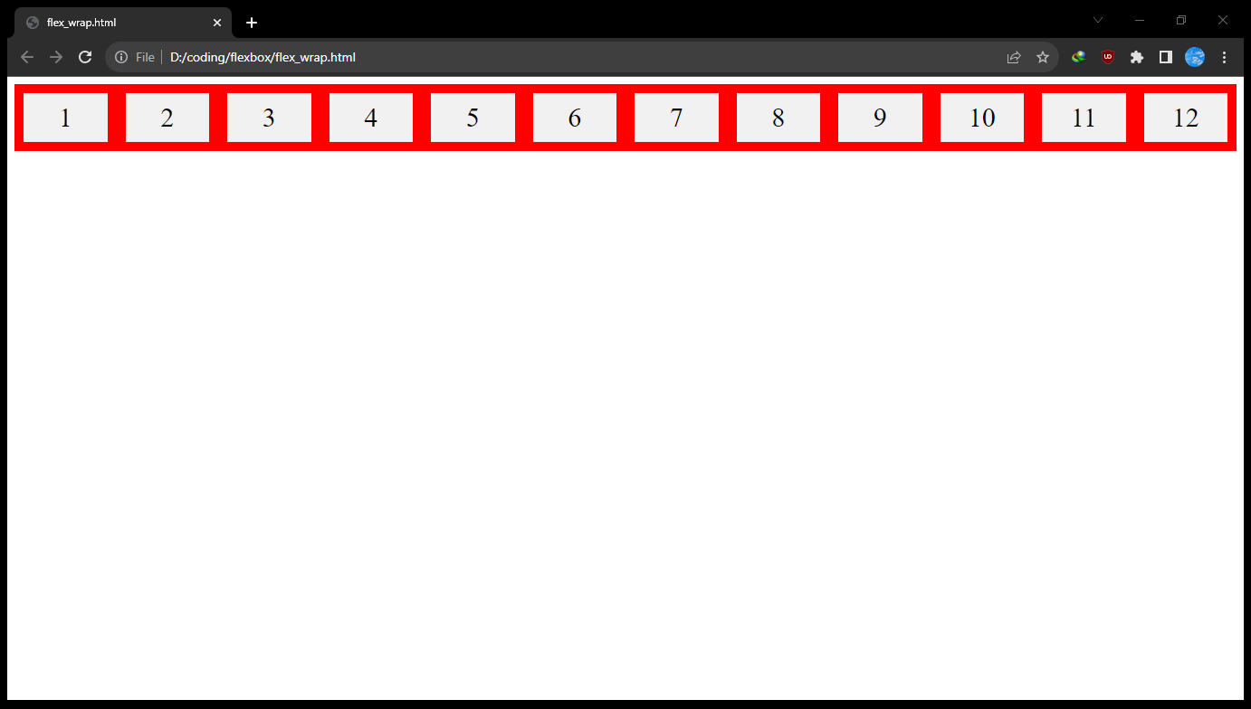
nowrap – make all flex-item fit into one line

Slide 21
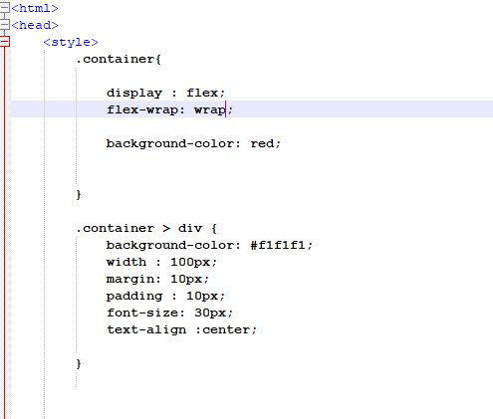
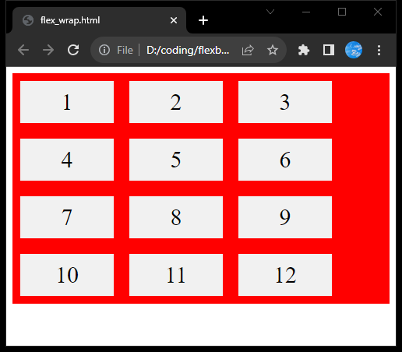
wrap – make all flex item into flexible state from top to bottom

Slide 22
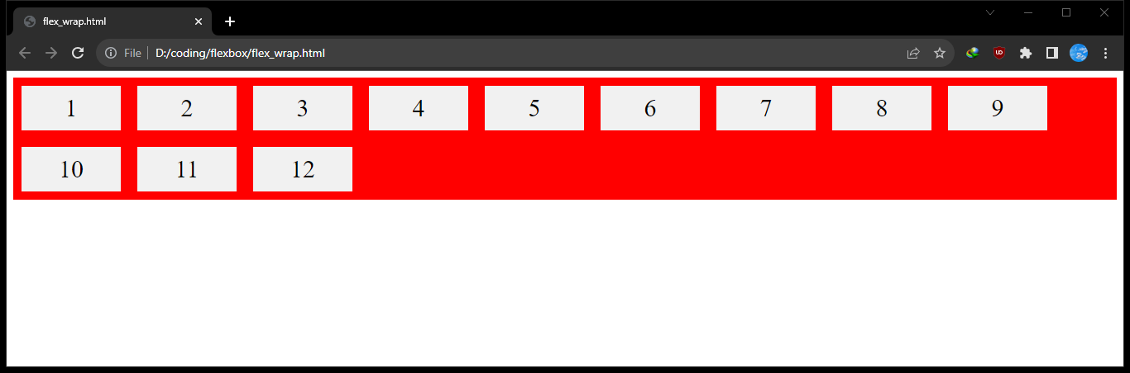

Slide 23
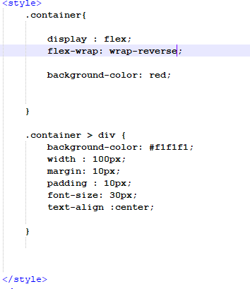
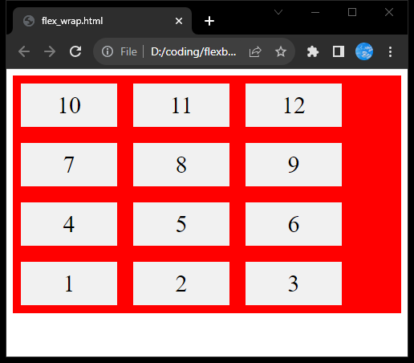
wrap-reverse – make all flex item into flexible state from bottom to top

Slide 24
Justify-content
It controls the position of flex items by adjusting the space from left or right.
There are three type of properties – flex-start, flex-end, center, space-between, space-around and space evenly.
Let’s demonstrate it…..

Slide 25
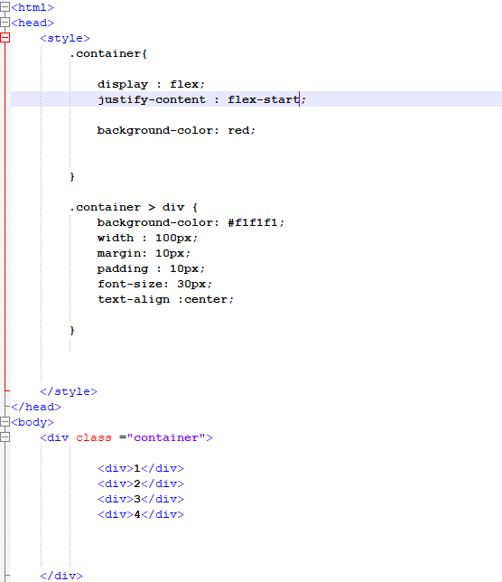
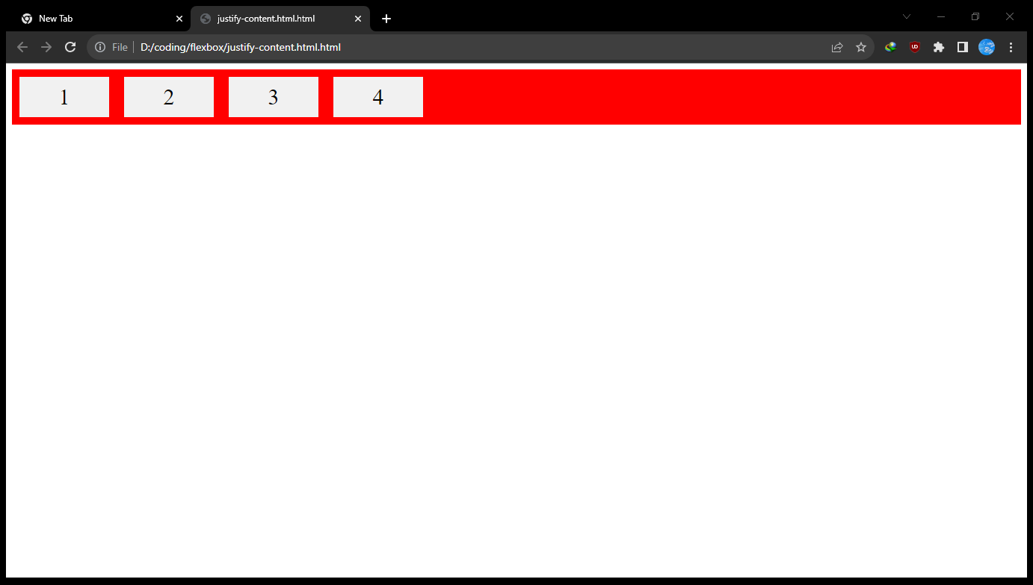
Flex-start – make all flex-item fit from start of the flex direction

Slide 26
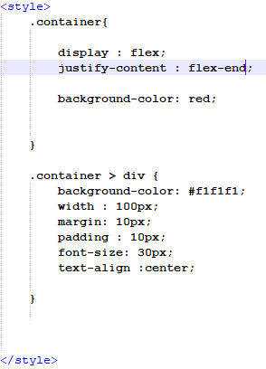
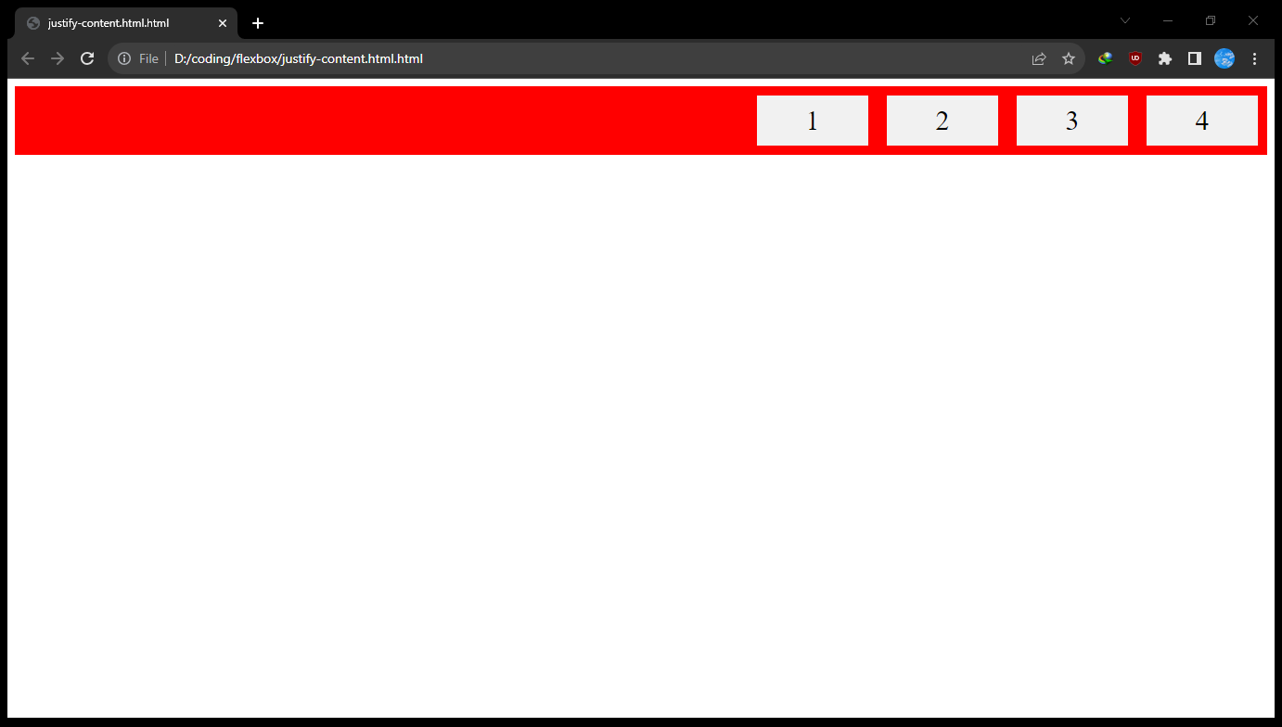
Flex-end – make all flex-item fit from end of the flex direction

Slide 27
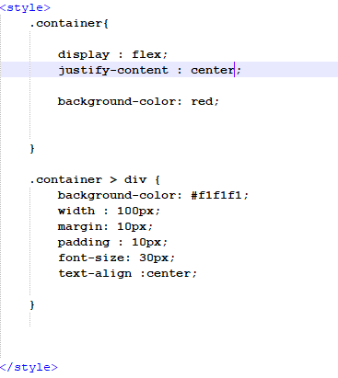
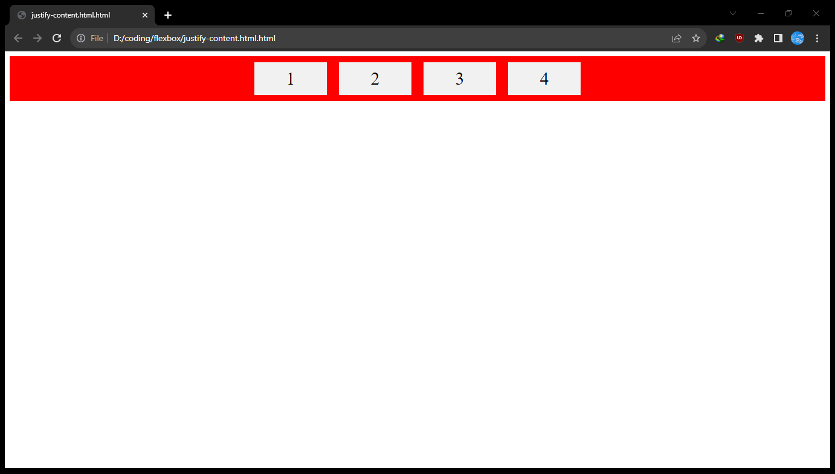
Flex-center – place all flex items center

Slide 28
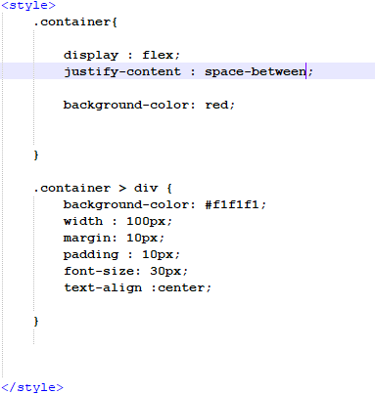
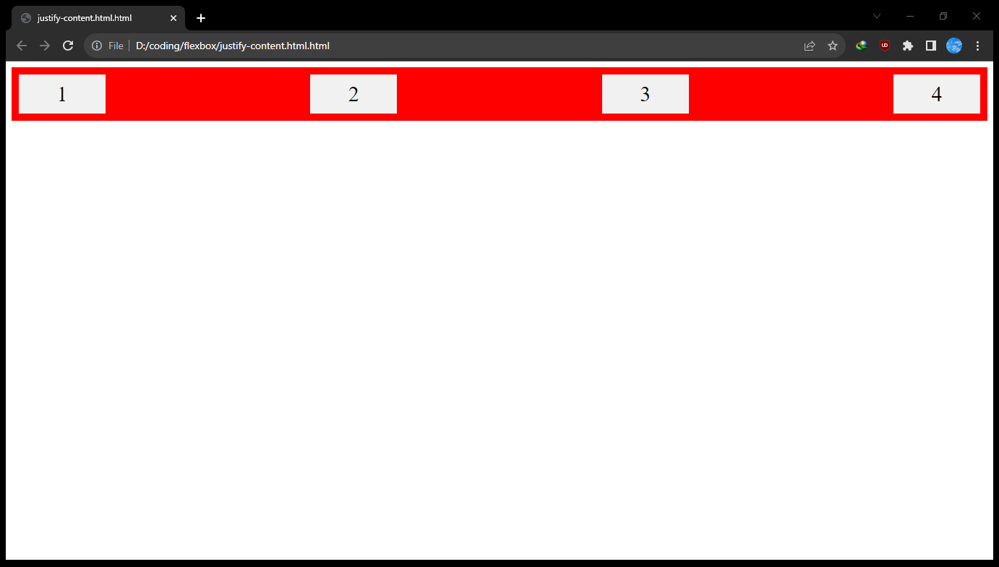
Space-between – display between each flex items with space

Slide 29
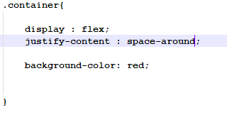
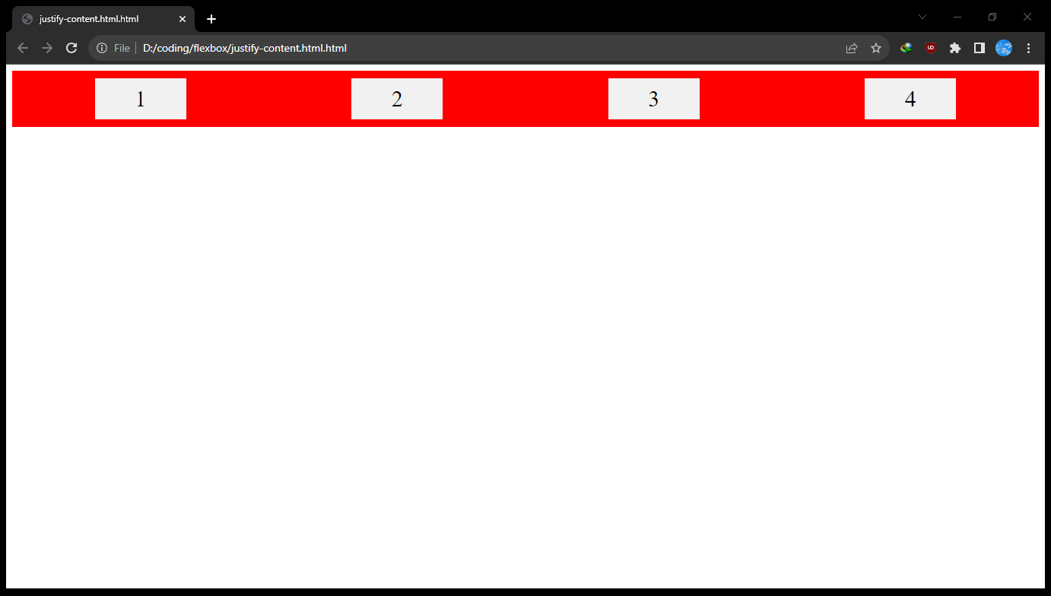
Space-around – place all each flex items with space before, between , after in space container

Slide 30
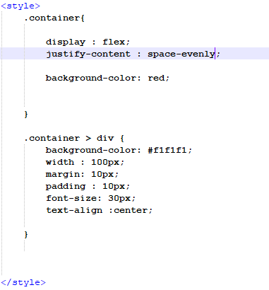
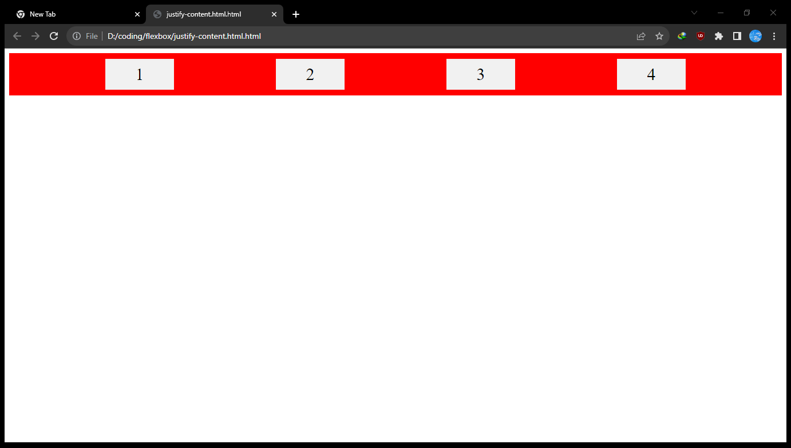
Space-evenly – display fist item and last item with large space than other items

Slide 31
Align-item
It controls the arrangement of flex items between top and bottom.
There are three type of properties – flex-start, flex-end, center, stretch and baseline.
Let’s demonstrate it…..

Slide 32
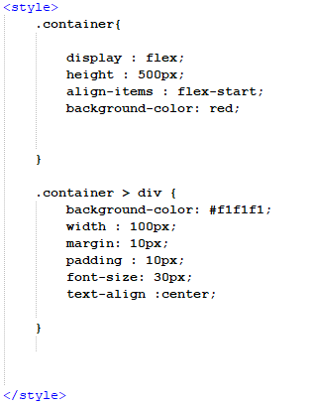
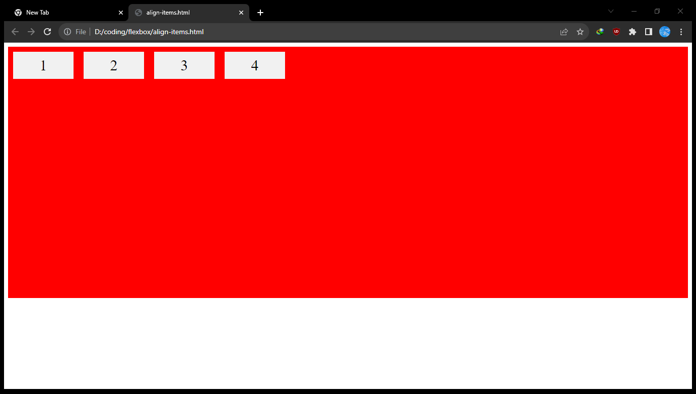
Align-item of flex-start – display flex item at the start of the cross axis

Slide 33
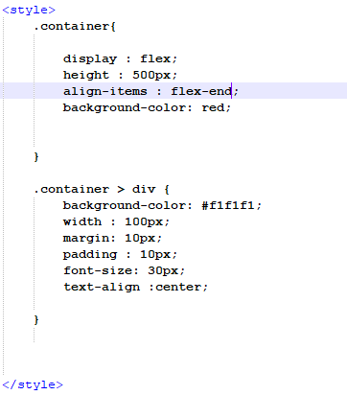
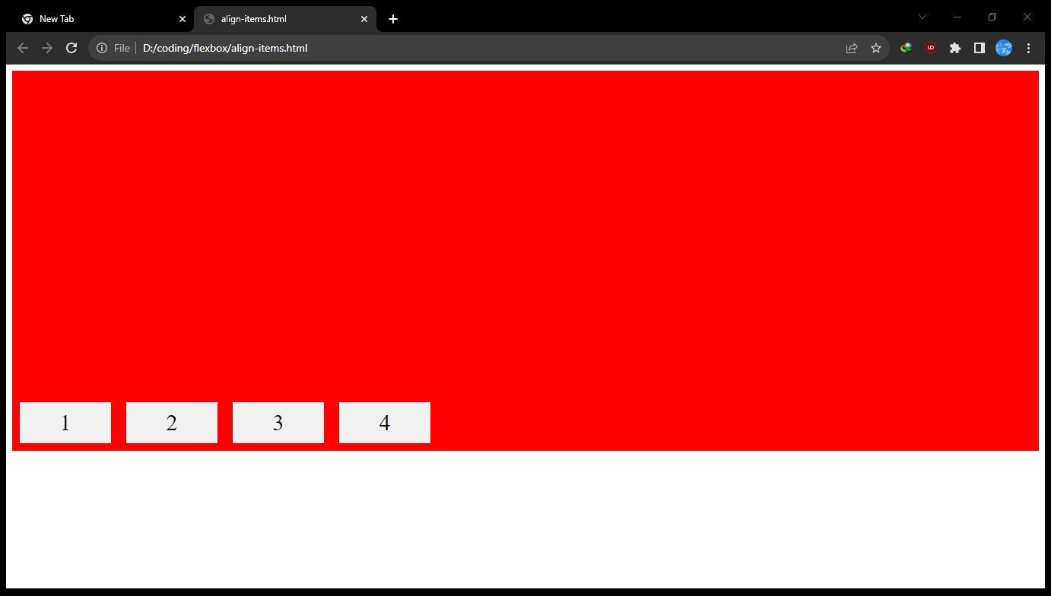
Align-item of flex-end – display flex item at the end of the cross axis

Slide 34
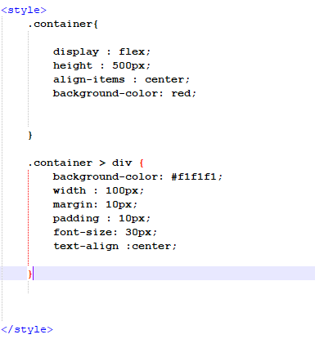
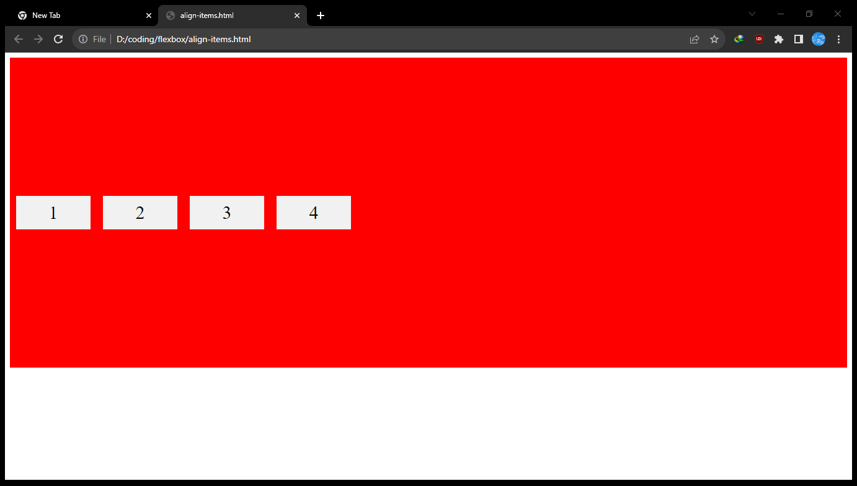
Align-item of center – display flex item at the center of the cross axis

Slide 35
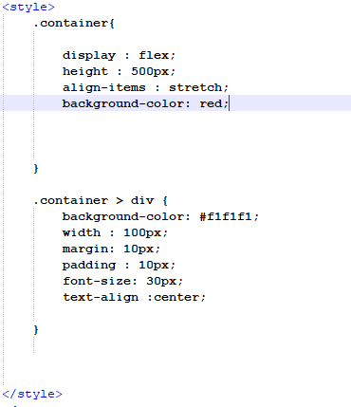
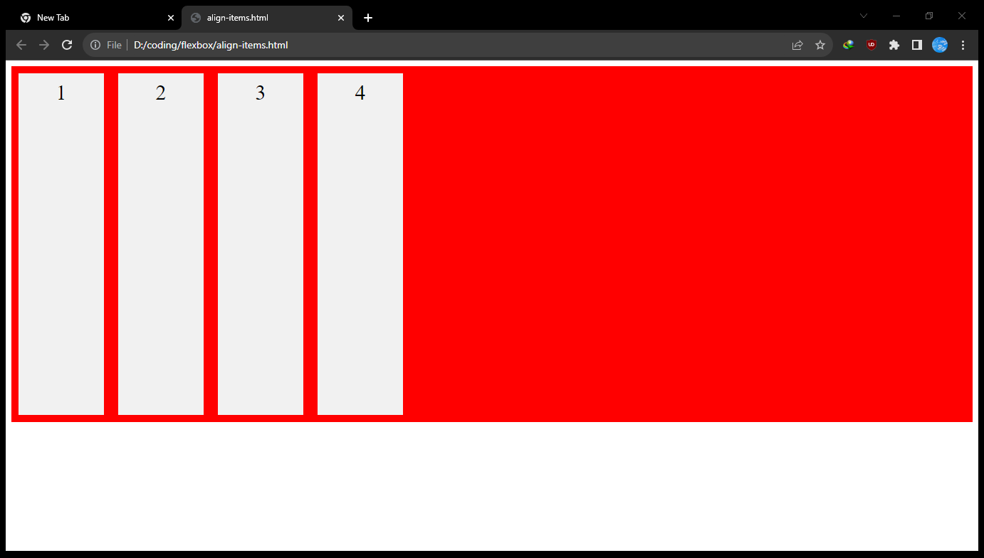
Align-item of stretch– stretch the height of flex item within cross axis

Slide 36
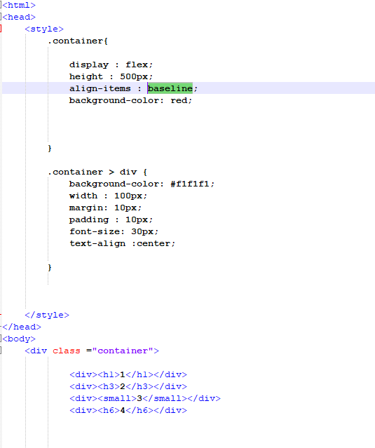
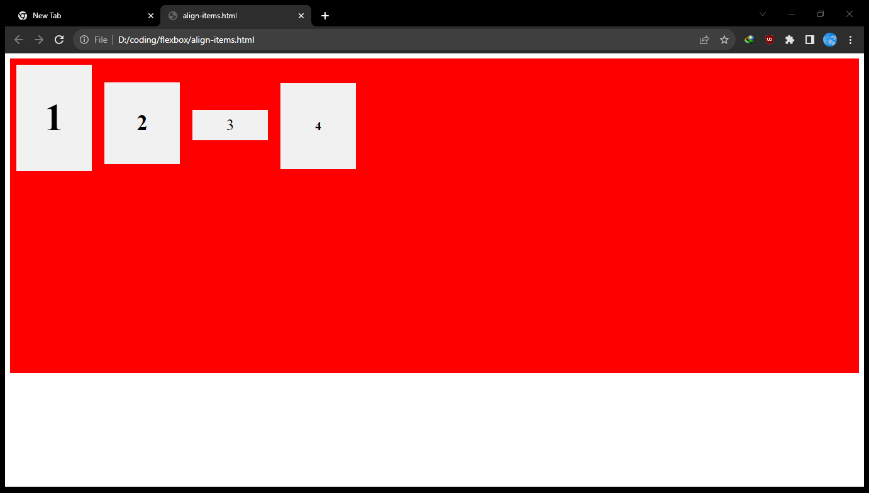
Align-item of baseline– stretch the height of flex item within cross axis

Slide 37
Align-content
It displays flex item with extra space of column axis in the flex container.
There are three type of properties – flex-start, flex-end, center, stretch, space-between and space-around.
Let’s demonstrate it…..

Slide 38
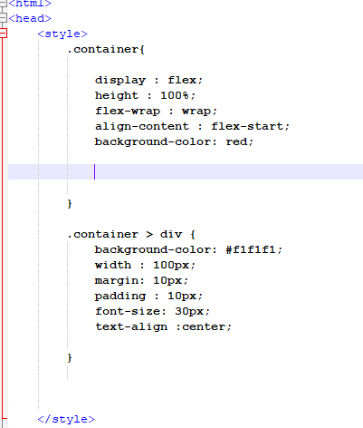
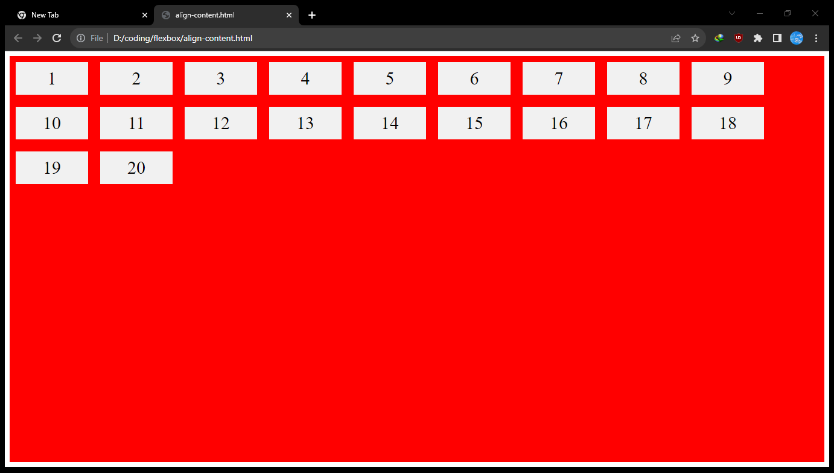
Align content of flex start– display flex items at the start of the flex container

Slide 39
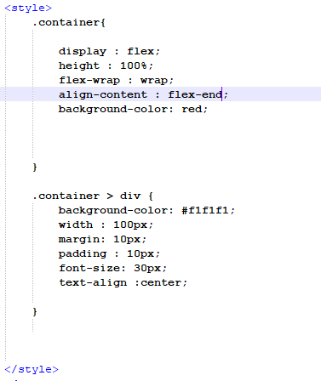
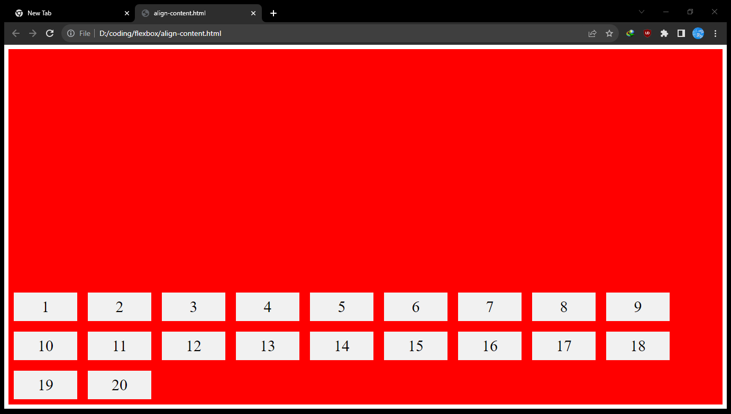
Align content of flex end– display flex items at the end of the flex container

Slide 40
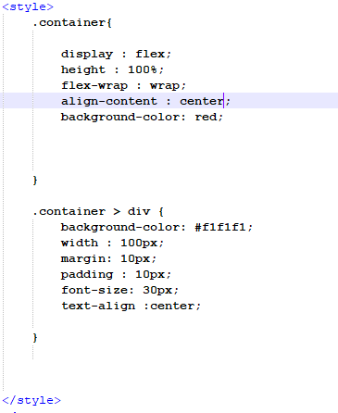
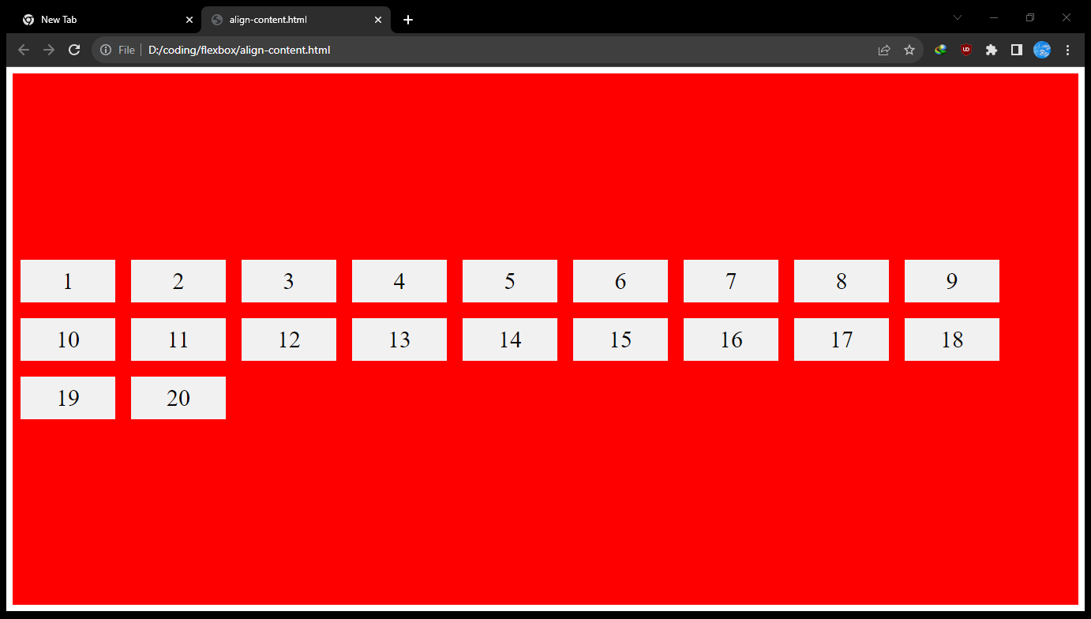
Align content of center – display flex items at the middle of the flex container

Slide 41
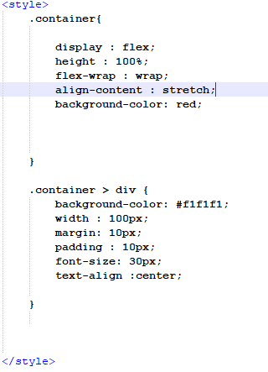
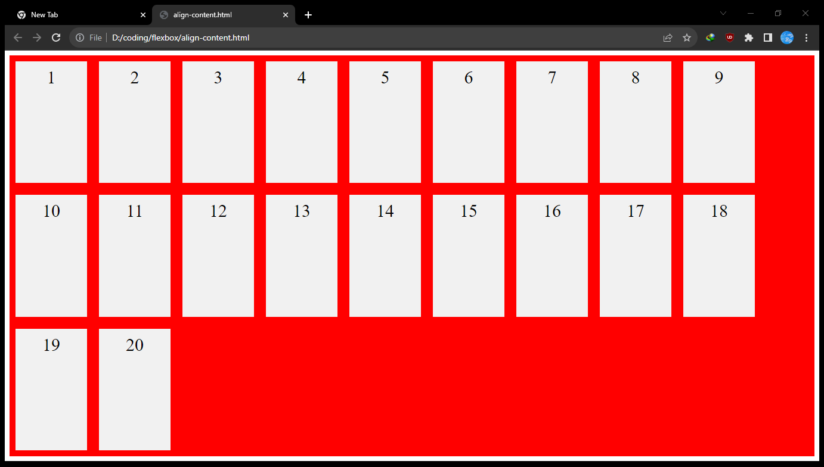
Align content of stretch – stretch the height of flex items in flex container

Slide 42
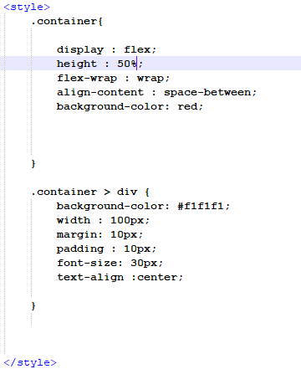
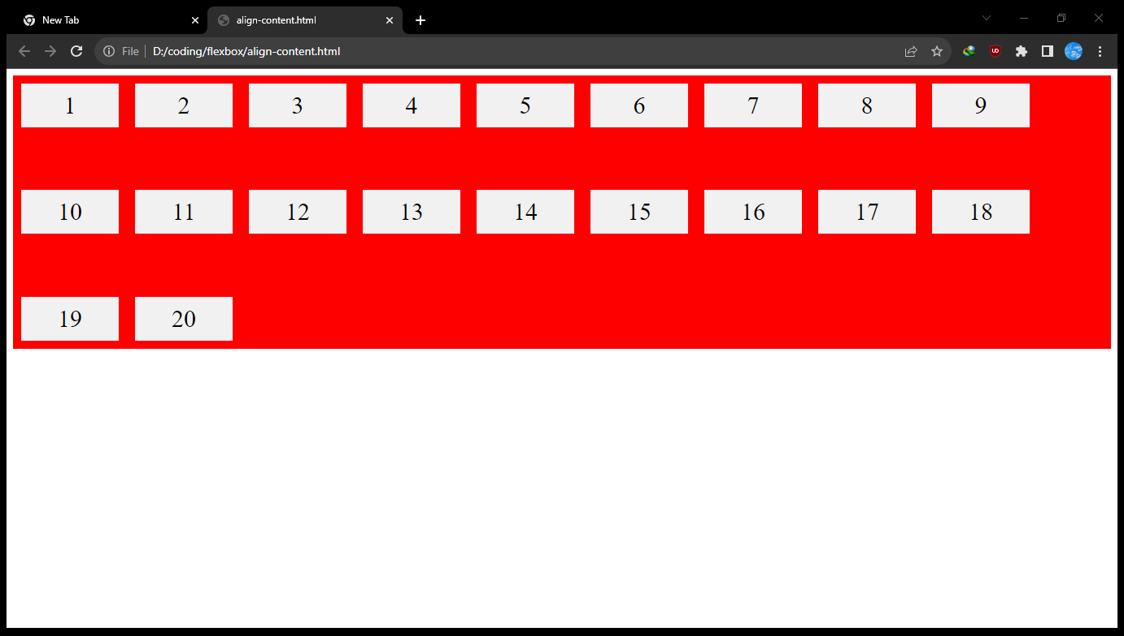
Align content of space-between – make space between each role of flex items

Slide 43


Align content of space-around – make space at the start and end of column axis in flex items

Slide 44
Thank you for your attention

